Slide 1
IMC: Inbound Digital Marketing

Slide 2

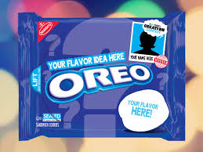

Inbound Marketing
Augment the brand offering
Support the brand offering
  Crowdsourcing
Amplify other brand-building activities —CSR programs
Create a customer “sweet spot”
  Brand relationships
  Brand community

Slide 3
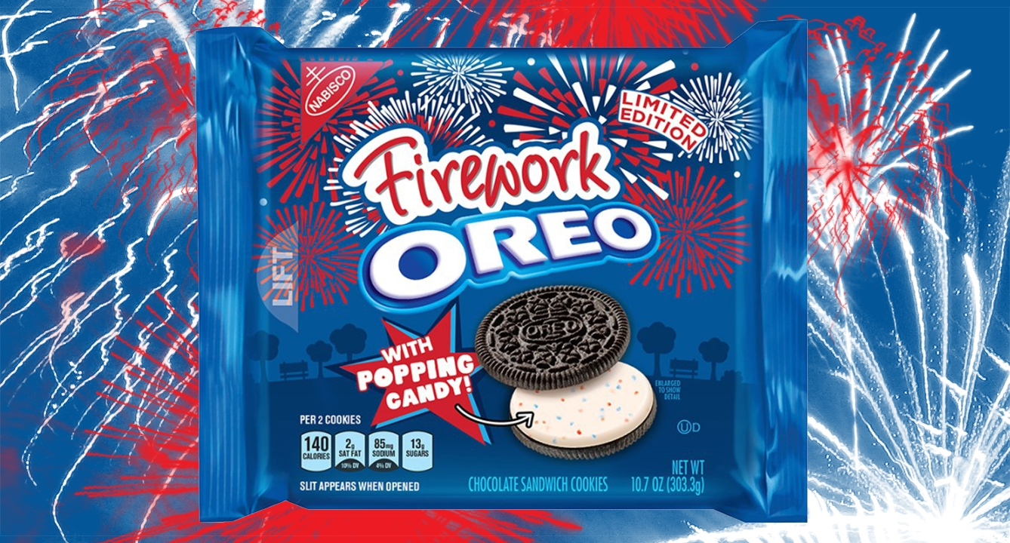
Crowdsourced Oreo Special Flavor

Slide 4

Inbound Branding
Key Principle #1: Concentrate on the relationships, not on the technologies (akin to features versus benefits); the overriding goal should be customer engagement
Key Principle #2: Content is (still) king
  Information relevance
  Entertainment
  Blend of both is ideal

Slide 5

IKEA Place (Augmented Reality)

Slide 6
Need a Content Strategy
Content strategy guides the company’s plans for the creation, delivery, and governance of brand content.
Works best when there is a clear purpose
  Build brand equity
  Attract web surfers
  Encourage loyalty
  Build community engagement

Slide 7
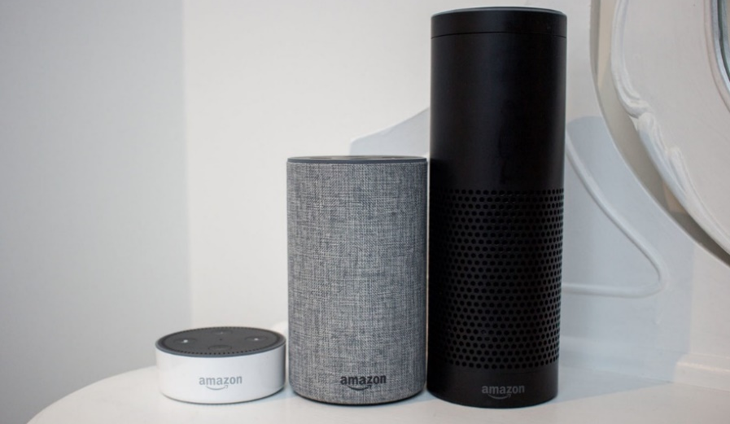
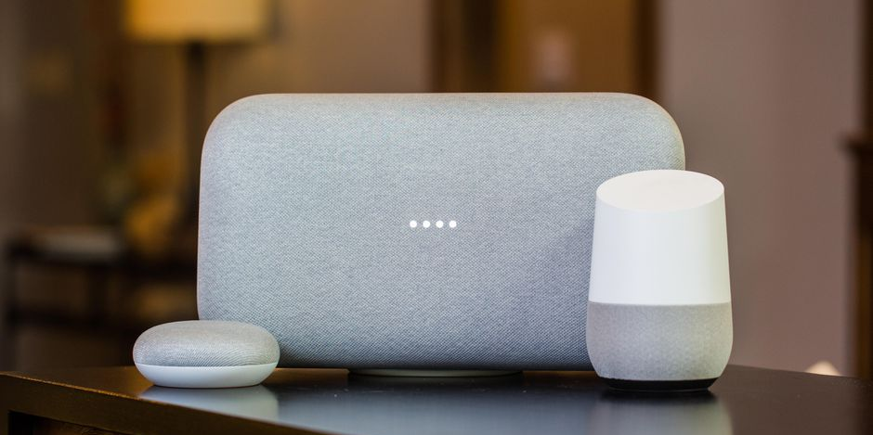
Branding for Virtual Assistants
Growing importance
Research the assistants’ AI algorithms
Establish a superior position vs. competitors
Innovate continuously
Stay in close touch with end users

Slide 8
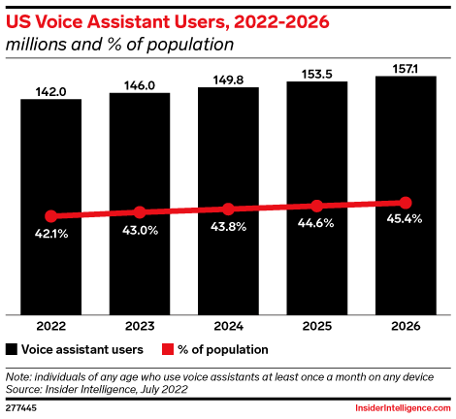
Number of Voice Assistant Users, 2022-2026

Slide 9
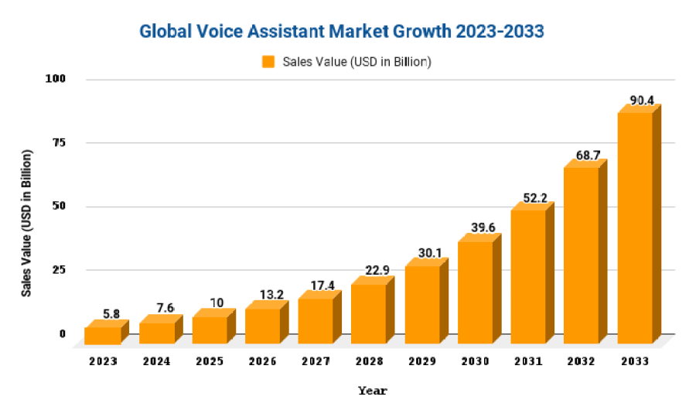
Growth of Global Voice Assistant Market
Marketresearch.Biz

Slide 10
Conclusion
Does your firm utilize inbound marketing?
Does your firm have a clear-cut content strategy?
Is your firm capitalizing on the emerging virtual assistant shopping channel?

Slide 11
End of Lecture

